Slide 1
INSERT LOGO
Low Back Pain Clinical Care Standard
INSERT MEETING TITLE
INSERT MEETING DATE
XX Month Year
Notes:
In September 2022, the Australian Commission on Safety and Quality in Health Care (the Commission) released the Low Back Pain Clinical Care Standard.
This PowerPoint has been developed to raise awareness of the new Standard and support Primary Health Networks to facilitate multidisciplinary education sessions on low back pain.
Slides and notes can be adapted to reflect local priorities and audience interests. Incorporating information on local pathways and services may increase relevance and engagement.

Slide 2
Back pain is a leading cause of disability worldwide and that burden is increasing
In Australia, back pain is the number one cause of:
LOST PRODUCTIVITY
EARLY RETIREMENT
INCOME POVERTY
SOURCES: Vos T et al, . Lancet 2017;390:1211–1259
Schofield DJ et al, Spine 2012;37:1156–63 Schofield DJ et al, Med J Aust 2015;203;e26-6.
LOST WORK PRODUCTIVITY
EARLY RETIREMENT
INCOME POVERTY
Notes:
Back pain is a problem experienced by a lot of people and encountered by many clinicians
It is the leading cause of disability worldwide, and that burden is increasing
And in Australia, back pain is the number one cause of lost work productivity, early retirement and income poverty.

Slide 3
Around 1 in 6
people in Australia report back problems
SOURCE: Australian Institute of Health and Welfare. Back problems, 2020.
Notes:
It is a really common condition with around 1 in 6 people in Australia reporting back problems
Back pain often leads to psychological distress and poorer quality of life – so it is important to break the cycle that leads to chronic problems.

Slide 4
Notes:
OPTIONAL VIDEO (3 minutes)
Press Ctrl+Click on the image (or follow the link below) to watch Joe's story about how the right treatment helped him overcome his low back pain.
https://www.youtube.com/watch?v=kgGxu6tEuzc

Slide 5
The Australian Atlases of Healthcare Variation have shown marked variation relevant to care of low back pain.
11.8x
4.8x
5%
variation in CT imaging for lumbar spine
variation in lumbar spine surgery admissions
increase in opioid prescribing over 4 years
(2013-14 to 2016-17)
SOURCE: Australian Atlas of Healthcare Variation Series
Notes:
The Commission develops clinical care standards for health conditions that would benefit from a national coordinated approach
The Australian Atlas of Healthcare Variation series found high levels of variation in a number of aspects of care for low back pain – including:
CT imaging for the lumbar spine
Spinal fusion and spinal decompression
Opioid prescribing
The Atlas identified that one way to address this variation could be to improve the early management of low back pain because it plays a critical role in determining patient outcomes.

Slide 6
This standard will help prevent acute episodes of low back pain becoming an ongoing problem.
Evidence-based, best-practice early management of acute presentations
Reduce the risk of recurrence
Reduce the risk of progression to chronic low back pain
Notes:
If the early management is done well it can reduce the risk of ongoing problems
Any acute presentation is an opportunity to ‘break the cycle’ that can lead to lifelong problems.
This might be a first episode of acute low back pain, a recurrence or an acute-on-chronic episode

Slide 7
In Australia, back problems are…
the second most common reason people go to their GP…
…and one of the top 5 reasons people present to the ED
SOURCE: GP ref - Britt et al. 2016 General practice activity in Australia 2015–16
AND: Australian Institute of Health and Welfare. Australian hospital statistics: emergency department care 2020–21.
Notes:
Back problems are the second most common reason Australians go to their GP, and one of the top 5 reasons people present to the emergency department
For this reason, the Standard has been developed with a focus on primary care and emergency departments, which is where most of that early management occurs

Slide 8
Risk of recurrence and progression after an episode of low back pain
75% will have a favourable outcome even without treatment
25% will develop ongoing symptoms and limitations
SOURCE: Stanton et al. Spine (Phila Pa 1976). 2008;33:2923-8
Notes:
Most people with an episode of low back pain improve rapidly with primary care management within the first six weeks
Three quarters of people with low back pain will get better without requiring any treatment
However, recurrence is common with around one-quarter of people who initially recover from an acute episode having additional episodes within a year.

Slide 9
Notes:
OPTIONAL VIDEO (2.41 minutes)
Press Ctrl+Click on the image (or follow the link below) to hear General Practitioner Associate Professor Liz Marles provide an overview of the key elements of the Standard.
https://youtu.be/48utqu_xeCg

Slide 10
Quality Statements
1. Initial clinical assessment
2. Psychosocial assessment
3. Reserve imaging for suspected serious pathology
4. Patient education and advice
5. Encourage self‑management and physical activity
6. Physical and/or psychological interventions
7. Judicious use of pain medicines
8. Review and referral
Notes:
The Low Back Pain Clinical Care Standard includes 8 quality statements with indicators to help clinicians and healthcare services with quality improvement activities.
Note – The quality statements are provided as optional additional slides 24 – 32 if you would like to go into any of the components of care in more detail.

Slide 11
Recognise the signs of serious pathology
Provide evidence-based care once serious pathology has been ruled out
Avoid unnecessary interventions
Notes:
The quality statements cover three key areas
Firstly, clinicians need to confidently identify signs of serious underlying pathology and know when to act on these - this is where imaging and referral may be appropriate
But it is important to remember that more than 95% of cases of low back pain do not have a serious underlying cause.

Slide 12
Recognise the signs of serious pathology
Initial assessment and management
Consider psychosocial factors
Patient education and advice to self-manage
Consider serious pathology
Referral
Imaging
Assess the need for physical, psychological therapies and/or analgesics
Notes:
To support clinicians to identify or rule out serious pathology, the Standard includes quality statements outlining:
The initial clinical assessment to screen for serious pathology – including a targeted history
The need for early and appropriate referral for imaging for patients with suspected serious pathology
The indications for emergency assessment or referral.
Note - To explore related quality statements in more detail, move slides 24 (Quality Statement 1) and slide 26 (Quality Statement 3) here.

Slide 13
Notes:
OPTIONAL VIDEO (1.46 minutes)
Press Ctrl+Click on the image (or follow the link below) to hear Musculoskeletal Physiotherapist Professor Peter O’Sullivan discuss some of the risks associated with inappropriate use of imaging for patients without signs of serious pathology.
https://youtu.be/Rw9AiJC2Ckw

Slide 14
Recognise the signs of serious pathology
Provide evidence-based care once serious pathology has been ruled out
Avoid unnecessary interventions
Notes:
Once a potentially serious cause has been ruled out, the Standard recommends adopting a more conservative approach with relatively simple measures
The evidence shows us that good patient education, reassurance and advice to stay active are vital
Many patients will need little more than education and advice, but it is important to consider their individual situation including any psychosocial factors that may affect their recovery

Slide 15
Provide evidence-based care
Initial assessment and management
Consider psychosocial factors
Patient education and advice to self-manage
Consider serious pathology
Referral
Imaging
Assess the need for physical, psychological therapies and/or analgesics
Notes:
The Standard outlines:
The need to support patients to stay active, maximise function, and limit the impact of pain on their daily life
The importance of psychosocial assessment to help identify risk of poor functional outcomes
The need for individualised information, advice and reassurance so that people feel confident about managing their pain and getting the support they need.
Note - To explore related quality statements in more detail, move slides 25 (Quality Statement 2), slide 27 (Quality Statement 4), slide 28 (Quality Statement 5) and slide 29 (Quality Statement 6) here.

Slide 16
Notes:
OPTIONAL VIDEO (2.22 minutes)
Press Ctrl+Click on the image (or follow the link below) to hear Clinical Psychologist Professor Michael Nicholas explain the importance of psychosocial assessment and management of low back pain.
https://youtu.be/3ksWhg5btMA

Slide 17
Provide evidence-based care (review/reassess)
Review progress
Adjust management if needed
Consider serious pathology
Respond to psychosocial factors
Adjust physical and/or psychological therapies, and pain medicines
Repeat patient education and advice to self-manage
Notes:
The Standard also covers the need to arrange follow-up to review and reassess patients that aren’t improving - reassuring patients that they will be checked again for serious causes if their symptoms progress.
Note - To explore related quality statements in more detail, move slides 31 (Quality Statement 8).

Slide 18
Provide evidence-based care (further referrals)
Referral for persisting or worsening symptoms, or new concerning features (according to individual need)
Integrated multidisciplinary approach
(e.g. multidisc pain clinic)
Appropriate medical, surgical or allied health referral
Notes:
And that the appropriate referral will be made for patients with persisting or worsening symptoms, or new concerning features.

Slide 19
Recognise the signs of serious pathology
Provide evidence-based care once serious pathology has been ruled out
Avoid unnecessary interventions
Notes:
One of the goals of the Standard is to reduce the use of unnecessary interventions
There is increasing evidence of the unintended consequences and harms of unnecessary interventions, such as imaging and high-risk pain medicines
The Standard emphasises the need to:
Support patients in shared decision making
Limit the routine use of imaging unless serious pathology is suspected. Not only are findings often poorly correlated with symptoms, they can contribute to unhelpful beliefs and behaviours
Ensure that pain medicines are used appropriately to avoid unnecessary side effects and the risk of dependence.
If we do these things well, we can prevent this very common and sometimes debilitating condition from becoming a long-term problem.
To explore related quality statements in more detail, move slide 25 (Quality Statement 2) and slide 30 (Quality Statement 7) here.

Slide 20
Notes:
OPTIONAL VIDEO (0.58 minutes)
Press Ctrl+Click on the image (or follow the link below) to hear General Practitioner Associate Professor Liz Marles discuss the use of pain medicines including opioid analgesics for low back pain and how they can be used effectively and safely to support recovery.
https://youtu.be/uXL0uum_qos

Slide 21
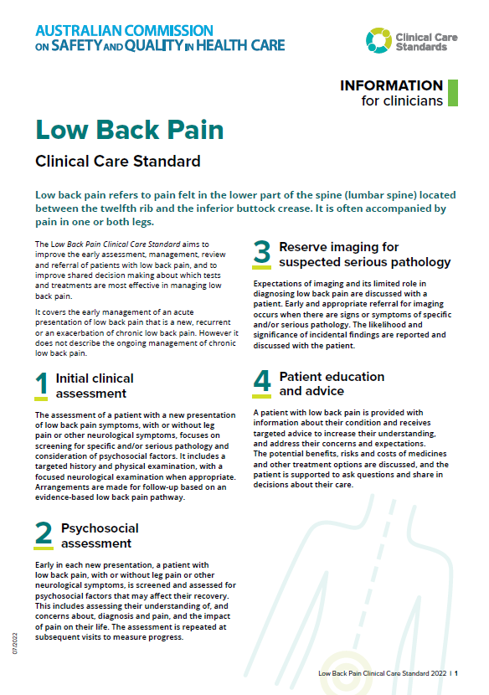
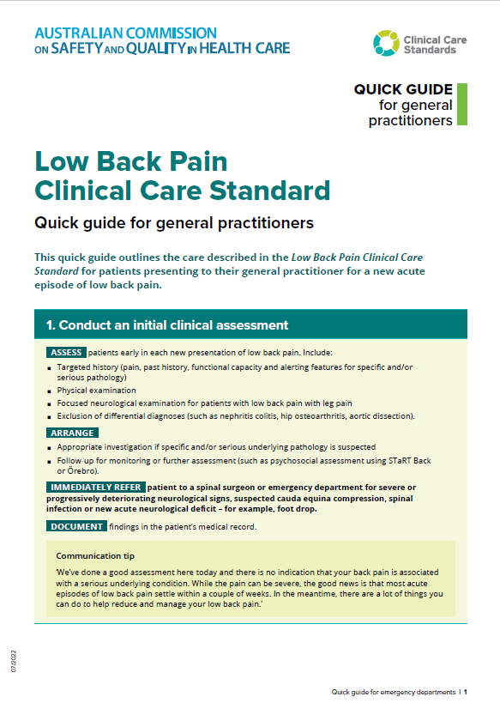
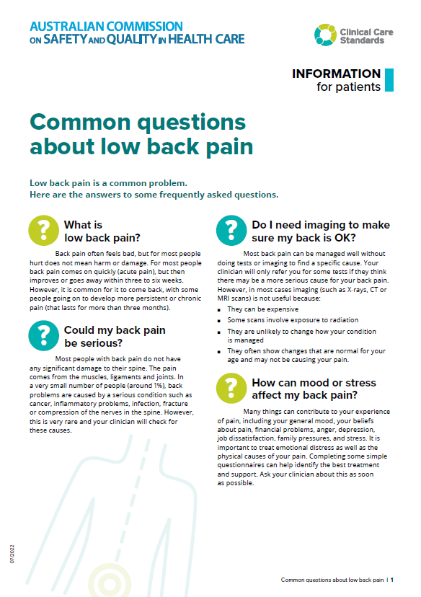
CLINICAL CARE STANDARD
FACTSHEETS
QUICK QUIDES FOR GPS AND EMERGENCY DEPARTMENTS
INFORMATION FOR CONSUMERS
Notes:
The Commission has developed a suite of resources to support implementation of the Standard including:
Fact sheets for clinicians, healthcare services and consumers
Quick guides for general practitioners and emergency department physicians
Patient information on self management and the nature of low back pain.
Note: You can press Ctrl+Click on each image to access the relevant resources.

Slide 22
Discussion
Notes:
OPTIONAL
Opportunity to discuss:
The implications of the Standard on local practice
Challenges and opportunities based on local experience

Slide 23
safetyandquality.gov.au/lowbackpain-ccs
Notes:
Most people will have low back pain at some point in their life
By not over-investigating and treating too quickly we can help patients to understand the natural progression of their condition and manage their expectations with good reassurance and advice.

Slide 24
Quality Statement
Notes:
OPTIONAL – Quality statements
Discuss the implications of this quality statement, and potential challenges and opportunities to implementation.
Further information about what this quality statement means for clinicians is available on pages 14 – 16 of the Standard:
https://www.safetyandquality.gov.au/sites/default/files/2022-08/low_back_pain_clinical_care_standard.pdf

Slide 25
Quality Statement
Notes:
OPTIONAL – Quality statements
Discuss the implications of this quality statement, and potential challenges and opportunities to implementation.
Further information about what this quality statement means for clinicians is available on page 20 of the Standard:
https://www.safetyandquality.gov.au/sites/default/files/2022-08/low_back_pain_clinical_care_standard.pdf

Slide 26
Quality Statement
Notes:
OPTIONAL – Quality statements
Discuss the implications of this quality statement, and potential challenges and opportunities to implementation.
Further information about what this quality statement means for clinicians is available on pages 23 - 26 of the Standard:
https://www.safetyandquality.gov.au/sites/default/files/2022-08/low_back_pain_clinical_care_standard.pdf

Slide 27
Quality Statement
Notes:
OPTIONAL – Quality statements
Discuss the implications of this quality statement, and potential challenges and opportunities to implementation.
Further information about what this quality statement means for clinicians is available on page 29 of the Standard:
https://www.safetyandquality.gov.au/sites/default/files/2022-08/low_back_pain_clinical_care_standard.pdf

Slide 28
Quality Statement
Notes:
OPTIONAL – Quality statements
Discuss the implications of this quality statement, and potential challenges and opportunities to implementation.
Further information about what this quality statement means for clinicians is available on page 32 of the Standard:
https://www.safetyandquality.gov.au/sites/default/files/2022-08/low_back_pain_clinical_care_standard.pdf

Slide 29
Quality Statement
Notes:
OPTIONAL – Quality statements
Discuss the implications of this quality statement, and potential challenges and opportunities to implementation.
Further information about what this quality statement means for clinicians is available on pages 35 - 36 of the Standard:
https://www.safetyandquality.gov.au/sites/default/files/2022-08/low_back_pain_clinical_care_standard.pdf

Slide 30
Quality Statement
Notes:
OPTIONAL – Quality statements
Discuss the implications of this quality statement, and potential challenges and opportunities to implementation.
Further information about what this quality statement means for clinicians is available on page 40 of the Standard:
https://www.safetyandquality.gov.au/sites/default/files/2022-08/low_back_pain_clinical_care_standard.pdf

Slide 31
Quality Statement
Notes:
OPTIONAL – Quality statements
Discuss the implications of this quality statement, and potential challenges and opportunities to implementation.
Further information about what this quality statement means for clinicians is available on pages 43 - 44 of the Standard:
https://www.safetyandquality.gov.au/sites/default/files/2022-08/low_back_pain_clinical_care_standard.pdf

