Slide 1
The foundations of Infection Prevention and control (IPC)
Infection Prevention and Control week 2023

Slide 2
Acknowledgement of Country
I would like to acknowledge the Traditional Owners and Custodians of the lands on which we meet today and pay my respects to Elders past, present and emerging.
I would like to extend that acknowledgement and respect to any Aboriginal and Torres Strait Islander peoples here today.
The artwork was designed for the Commission ‘s Reconciliation Action Plan by Kylie Hill, a proud Kalkadoon and Waanyi woman from Mount Isa in far North Queensland.

Slide 3
Instructions for use
This presentation is a framework for building a local infection prevention and control (IPC) presentation.
These slides include the key topic areas:
The basic principles of IPC
Standard precautions
Transmission-based precautions
Other strategies for IPC
You can adapt the information under each topic area with examples or information that is relevant to your staff and health service organisation.
The notes in this PowerPoint include examples of other information you could add to the presentation.

Slide 4
Basic principles of Infection prevention and Control (IPC)
Colonisation and infection
Microorganisms (infectious agents) are the main causes of infections and exist naturally in the environment. They do not always cause infection, and some microorganisms, like certain types of bacteria, are actually beneficial and are part of the body's normal flora, providing protection and other health benefits.
Definitions
Colonisation: The sustained presence of replicating infectious agents on, or in, the body but without any evidence of infection or disease. Colonisation may progress to infection and is a potential source of transmission to others
Infection: The invasion by, and reproduction of, pathogenic (disease-causing) organisms inside the body.

Slide 5
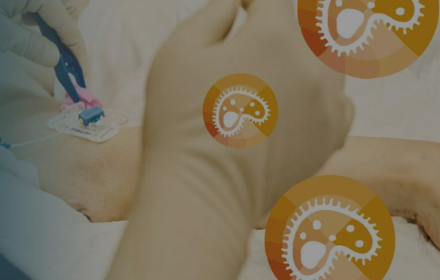
Healthcare-associated Infections (HAIs)
Healthcare-associated infection (HAI) are infections that are acquired as a direct or indirect result of healthcare. It can lead to additional complications for patients and their families, as well as longer hospital stays.
HAIs can occur in various settings, such as hospitals or community-based health services. Both patients and healthcare workers are at risk of HAIs.
Common HAIs include:
Staphylococcus aureus bloodstream infection (SABSI)
Surgical site infections (SSI)
Clostridioides difficile infection (CDI)
Notes:
IDEAS TO ADAPT FOR LOCAL USE:
Does your organisation monitor HAIs?
What the common HAIs in your organisations?
Are the quality improvement programs in place to reduce the risk of HAIs?

Slide 6
Chain of Infection
The transmission of infectious agents occurs via a series of interlinked events called the ‘Chain of Infection’.
For transmission of an infectious agent to occur, all the following elements are required:
Infectious agent (pathogen)
Reservoir
Portal of exit
Means of transmission
Portal of entry
Susceptible host.
Notes:
IDEAS TO ADAPT FOR LOCAL USE: add a new slide with either:
further explanations about each element or examples of each element
develop a scenario which demonstrates the spread of an infectious agent ( e.g. measles, or norovirus)
Explain how interruption to the chain of infection stops the spread of infection

Slide 7
The role of IPC
IPC aims to prevent the spread of infectious agents. There are two types of precautions used for IPC:
Standard precautions
Transmission-based precautions.
It’s critical to understand the means of transmission and how and when to use precautions to prevent and control the spread of infectious agents.
A risk management framework will help to prevent and minimise harm from HAIs.
The hierarchy of controls is a model used in work health and safety management to control hazards that ranks controls from most to least reliable. Use hierarchy of controls in conjunction with IPC to identify and manage infection risks.
Notes:
IDEAS TO ADAPT FOR LOCAL USE:
Describe risk assessment and management in IPC, provide examples of risk assessment such as selecting PPE, patient placement or enhanced environmental cleaning
How does the hierarchy of controls relate to IPC?

Slide 8
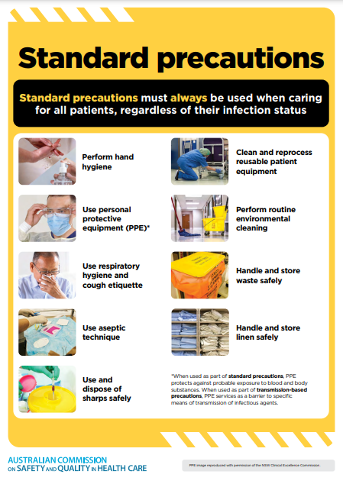
Standard precautions
Standard precautions are:
Minimum infection prevention and control practices that must always be used - for all patients in all situations
Used to reduce or prevent the transmission of infectious agents/germs and to render and maintain objects and healthcare settings as free as possible from infectious agents.
Notes:
Standard precautions involve:
hand hygiene, as consistent with the 5 moments for hand hygiene
the use of appropriate personal protective equipment
the safe use and disposal of sharps
routine environmental cleaning
reprocessing of reusable medical equipment and instruments
respiratory hygiene and cough etiquette
aseptic technique
waste management
appropriate handling of linen.
IDEAS TO ADAPT FOR LOCAL USE:
Expand on each intervention, how does hand hygiene, PPE use, aseptic technique etc help reduce the spread of infection to both healthcare workers and health consumers
Add links or references to resources that support implementation of each intervention. For example, for hand hygiene, you can link to the National Hand Hygiene Imitative (NHHI) and explain when to apply the 5 moments of hand hygiene in patient care.
Or focus on one or two specific interventions (PPE use or aseptic technique) if you know that these are areas of practice that your staff need some help with.

Slide 9
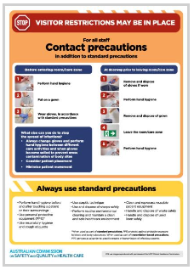
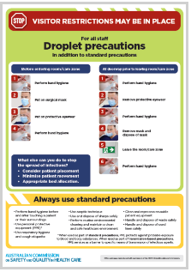
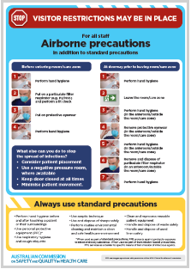
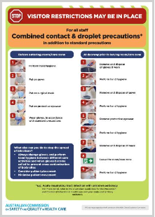
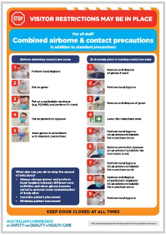
Transmission-based precautions
Transmission-based precautions are used to interrupt the specific means of transmission of a particular infectious agent. They are used in addition to standard precautions.
There are three categories of transmission-based precautions:
Contact precautions
Droplet precautions
Airborne precautions
For some infectious agents, a combination of precautions may be required (e.g. respiratory syncytial virus [RSV] require both contact and droplet precautions).
Notes:
Understanding the means of transmission of an infectious agent is important for deciding the most appropriate transmission-based precautions to use.
IDEAS TO ADAPT FOR LOCAL USE:
Expand on the interventions required for contact, droplet and airborne precautions ( PPE use, mask fit checking, patient placement, environmental cleaning)
Give examples or scenarios for when to use transmission-based precautions in addition to standard precautions- relate back the chain of infection
What are local processes for managing patients who require transmission-based precautions? Electronic flagging/codes in notes/ clinical documentation/ care plans/ communication
What information to patients and their carers need?

Slide 10
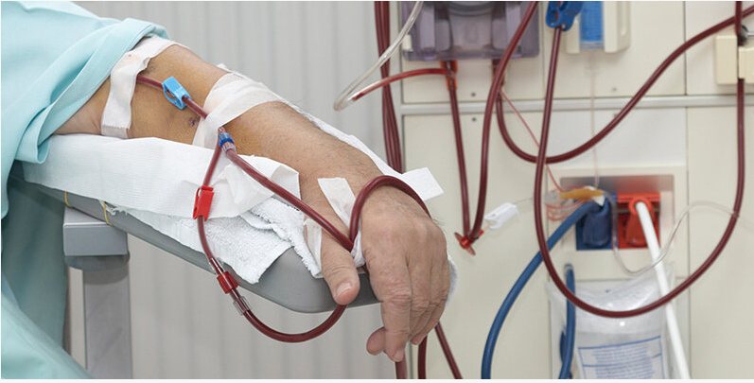
Other strategies for IPC - Managing invasive medical devices
Invasive medical devices are a common source of HAIs and provide a route for infectious agents to enter the body
Before inserting any invasive medical device, patients should always be assessed to determine:
If their condition can be managed without the insertion of an invasive medical device
The most appropriate invasive device, if required
How long the device will be required
What plan is in place to ensure timely removal of the device.
Notes:
IDEAS TO ADAPT FOR LOCAL USE:
add locally used invasive medical devices ( for example: urinary catheters, peripheral intravenous catheters, feeding tubes)
refer to local policies/ guidelines for the management of invasive devices
what quality improvement programs are in place to reduce the risk of infection from invasive devices?
what are the local infection rates related to invasive devices? ( blood stream infections?)
what do patients and their carers need to know about their invasive devices?

Slide 11
Tips to manage invasive medical devices
The longer the invasive medical device is in place, the greater the risk of infection or other complications developing related to the device.
The dwell time for an invasive medical device should be as short as possible.
Ask yourself:
What are the processes for monitoring and documentation for invasive medical devices?
Do you know the local rates of HAIs related to invasive devices?
Are there alternative options to putting in this device?
Notes:
IDEAS TO ADAPT FOR LOCAL USE:
add locally used invasive medical devices ( for example: urinary catheters, peripheral intravenous catheters, feeding tubes)
refer to local policies/ guidelines for the management of invasive devices
what quality improvement programs are in place to reduce the risk of infection from invasive devices?
what are the local infection rates related to invasive devices? ( blood stream infections?)
what do patients and their carers need to know about their invasive devices?

Slide 12
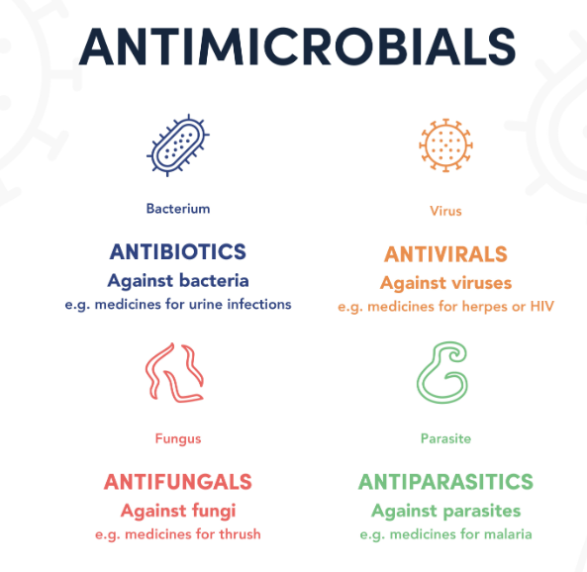
Antimicrobial resistance
Antimicrobial resistance (AMR) is recognised as a significant global health priority. Resistance to antimicrobials is commonly found in Australian hospitals and increasing in the community. This resistance can have a significant impact on morbidity, mortality, and treatment costs.
A significant driver of antimicrobial resistance is the unnecessary or inappropriate use of antimicrobials.
Notes:
IDEAS TO ADAPT FOR LOCAL USE:
What are the most common resistant strains in your organisation?
Who is most at risk? Where are the high risk settings in your organisation ( ICU, transplant units/ other areas)
What local IPC interventions help to reduce the risk of AMR? Screening programs, decolonisation programs
What are the locally emerging resistant organisms? Fungi, viruses, bacteria
What do patients and their carers need to know about multidrug-resistant organisms (MROs)?

Slide 13
Preventing infections to prevent microbial resistance
Preventing infection reduces the need for antimicrobials and the opportunity for organisms to develop resistance.
A risk management approach should be used to prevent and control multidrug-resistant organisms (MROs) in all health service organisations.
This should include:
Standard precautions for all patient care always
The use of transmission-based precautions where a patient is known or suspected to be colonised with a MRO.
Notes:
IDEAS TO ADAPT FOR LOCAL USE:
What are the most common resistant strains in your organisation?
Who is most at risk? Where are the high risk settings in your organisation ( ICU, transplant units/ other areas)
What local IPC interventions help to reduce the risk of AMR? Screening programs, decolonisation programs
What are the locally emerging resistant organisms? Fungi, viruses, bacteria
What do patients and their carers need to know about multidrug-resistant organisms (MROs)?

Slide 14
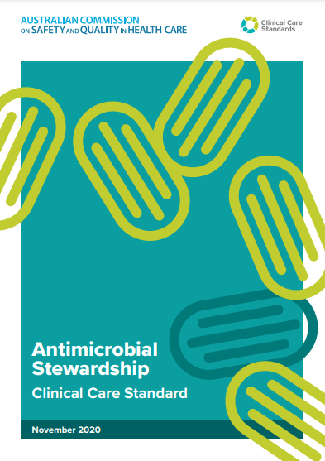
Other strategies for IPC - Antimicrobial stewardship
Antimicrobial stewardship (AMS) is a suite of coordinated activities which promote the appropriate prescribing and use of antimicrobials. AMS is conducted at all levels of the healthcare system, from local hospitals and general practices to national programs.
It is intended to improve the safety and appropriateness of use, and maximise the benefit of antimicrobials to reduce patient harm and prevent and contain antimicrobial resistance in Australia.

Slide 15
Antimicrobial stewardship
Key points to consider when prescribing and administering antimicrobials:
Is this the right antimicrobial/ dose for this patient’s condition?
Is oral or intravenous medication appropriate?
How frequently should this patient receive this antimicrobial medication?
How long will this patient require this antimicrobial medication?
Are there other patient factors that may affect the choice of antimicrobial medication, such as age, weight, renal function, allergies, other health conditions?
Is this antimicrobial being prescribed for surgical or other prophylaxis?
How many doses have been charted? Will this prescription be required for greater than 24 hours?
Notes:
IDEAS TO ADAPT FOR LOCAL USE:
Is there a local AMS program?
Who is involved?
What are the outcomes of the local AMS program?

